Slide 1
String Functions
Sir Shoukat Malik BS.Software Engineering SSUET Karachi

Slide 2
C – String
C Strings are nothing but array of characters ended with null character (‘\0’).
This null character indicates the end of the string.
Strings are always enclosed by double quotes. Whereas, character is enclosed by single quotes in C.

Slide 3
EXAMPLE FOR C STRING:
char string[20] = {‘f’, ’r’, ‘e’, ‘s’, ‘h’, ‘2’, ‘r’, ‘e’, ‘f’, ’r’, ‘e’, ‘s’, ‘h’, ‘\0’}; (or)
char string[20] = “fresh2refresh”; (or)
char string [] = “fresh2refresh”;
Difference between above declarations are, when we declare char as “string[20]”, 20 bytes of memory space is allocated for holding the string value.
When we declare char as “string[]”, memory space will be allocated as per the requirement during execution of the program.

Slide 4
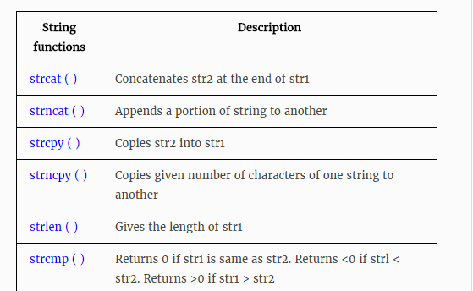
C STRING FUNCTIONS

Slide 5
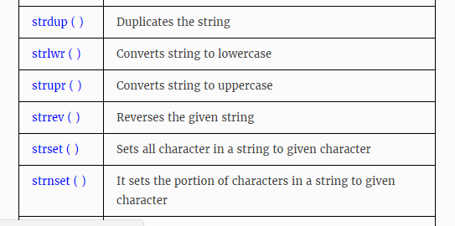
Continue……..

Slide 6
C – strcat() function
strcat( ) function in C language concatenates two given strings. It concatenates source string at the end of destination string. Syntax for strcat( ) function is given below. char * strcat ( char * destination, const char * source );
Example: strcat ( str2, str1 ); – str1 is concatenated at the end of str2. strcat ( str1, str2 ); – str2 is concatenated at the end of str1.
As you know, each string in C is ended up with null character (‘\0’).
In strcat( ) operation, null character of destination string is overwritten by source string’s first character and null character is added at the end of new destination string which is created after strcat( ) operation.

Slide 7
EXAMPLE PROGRAM FOR STRCAT ( ) FUNCTION IN C :
#include <stdio.h>
#include <string.h>
int main( )
{
char source[ ] = " fresh2refresh" ;
char target[ ]= " C tutorial" ;
printf ( "\nSource string = %s", source ) ;
printf ( "\nTarget string = %s", target ) ;
strcat ( target, source ) ;
printf ( "\nTarget string after strcat( ) = %s", target ) ;
}

Slide 8
C – strcpy() function
strcpy( ) function copies contents of one string into another string. Syntax for strcpy function is given below. char * strcpy ( char * destination, const char * source );
Example: strcpy ( str1, str2) – It copies contents of str2 into str1. strcpy ( str2, str1) – It copies contents of str1 into str2.
If destination string length is less than source string, entire source string value won’t be copied into destination string.
For example, consider destination string length is 20 and source string length is 30. Then, only 20 characters from source string will be copied into destination string and remaining 10 characters won’t be copied and will be truncated.

Slide 9
EXAMPLE PROGRAM FOR STRCPY( ) FUNCTION IN C:
#include <stdio.h> #include <string.h> int main( ) { char source[ ] = "fresh2refresh" ; char target[20]= "" ; printf ( "\nsource string = %s", source ) ; printf ( "\ntarget string = %s", target ) ; strcpy ( target, source ) ; printf ( "\ntarget string after strcpy( ) = %s", target ) ; return 0; }

Slide 10
C – strlen() function
strlen( ) function in C gives the length of the given string. Syntax for strlen( ) function is given below. size_t strlen ( const char * str );
strlen( ) function counts the number of characters in a given string and returns the integer value.
It stops counting the character when null character is found. Because, null character indicates the end of the string in C.

Slide 11
EXAMPLE PROGRAM FOR STRLEN() FUNCTION IN C:
#include <stdio.h>
#include <string.h>
int main( )
{
int len;
char array[20]="fresh2refresh.com" ;
len = strlen(array) ;
printf ( "\string length = %d \n" , len ) ;
return 0;
}

Slide 12
C – strcmp() function
strcmp( ) function in C compares two given strings and returns zero if they are same.
If length of string1 < string2, it returns < 0 value. If length of string1 > string2, it returns > 0 value. Syntax for strcmp( ) function is given below. int strcmp ( const char * str1, const char * str2 );
strcmp( ) function is case sensitive. i.e, “A” and “a” are treated as different characters.

Slide 13
EXAMPLE PROGRAM FOR STRCMP( ) FUNCTION IN C:
In this program, strings “fresh” and “refresh” are compared. 0 is returned when strings are equal. Negative value is returned when str1 < str2 and positive value is returned when str1 > str2.

Slide 14
#include <stdio.h>
#include <string.h>
int main( )
{
char str1[ ] = "fresh" ;
char str2[ ] = "refresh" ;
int i, j, k ;
i = strcmp ( str1, "fresh" ) ;
j = strcmp ( str1, str2 ) ;
k = strcmp ( str1, "f" ) ;
printf ( "\n%d %d %d", i, j, k ) ;
return 0;
}

Slide 15
C – strlwr() function
trlwr( ) function converts a given string into lowercase. Syntax for strlwr( ) function is given below. char *strlwr(char *string);
strlwr( ) function is non standard function which may not available in standard library in C.
In this program, string “MODIFY This String To LOwer” is converted into lower case using strlwr( ) function and result is displayed as “modify this string to lower”.

Slide 16
EXAMPLE PROGRAM FOR STRLWR() FUNCTION IN C:
#include<stdio.h>
#include<string.h>
int main()
{
char str[ ] = "MODIFY This String To LOwer";
printf("%s\n",strlwr (str));
return 0;
}

Slide 17
C – strupr() function
strupr( ) function converts a given string into uppercase. Syntax for strupr( ) function is given below. char *strupr(char *string);
strupr( ) function is non standard function which may not available in standard library in C.
In this program, string “Modify This String To Upper” is converted into uppercase using strupr( ) function and result is displayed as “MODIFY THIS STRING TO UPPER”.

Slide 18
EXAMPLE PROGRAM FOR STRUPR() FUNCTION IN C:
#include<stdio.h>
#include<string.h>
int main()
{
char str[ ] = "Modify This String To Upper";
printf("%s\n",strupr(str));
return 0;
}

Slide 19
C – strrev() function
strrev( ) function reverses a given string in C language. Syntax for strrev( ) function is given below. char *strrev(char *string);
strrev( ) function is non standard function which may not available in standard library in C.
In below program, string “Hello” is reversed using strrev( ) function and output is displayed as “olleH”.

Slide 20
EXAMPLE PROGRAM FOR STRREV() FUNCTION IN C:
#include<stdio.h>
#include<string.h>
int main()
{
char name[30] = "Hello";
printf("String before strrev( ) : %s\n",name);
printf("String after strrev( ) : %s",strrev(name));
return 0;
}

